Slide 1
Primary Keys Foreign Keys
Dr. Anne Powell
CMIS563

Slide 2
A Primary Key
Attribute(s) that uniquely identify an entity (relation) instance.
If you know the value of the primary key, you will be able to uniquely identify a single row.
You must be able to answer all three of these questions with these answers when selecting the primary key
Is the value unique? – Yes
Will the value ever need to be repeated? – No
Will the value ever be null? - No

Slide 3
A Composite Key
A composite key is a key that contains two or more attributes.
For a key to be unique, it must often become a composite key.

Slide 4
Identifying the primary key
Select the attribute
Underline it
EMPLOYEE (empID, empName, empAddr, empJob)
STUDENT (studentID, studentName, studentMajor)

Slide 5
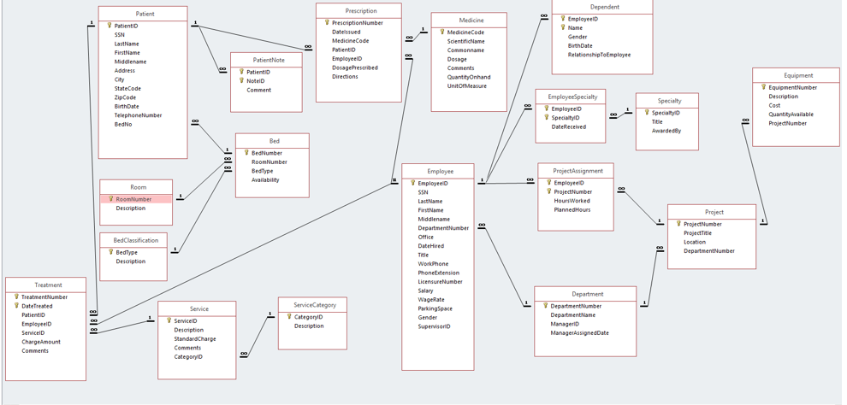

Slide 6
Relationships Between Tables
A table may be related to other tables.
For example
An Employee works in a Department
A Patient receives a Prescription
A Bed is assigned to a Patient

Slide 7
How do we relate tables? – A Foreign Key
To preserve relationships, you may need to create a foreign key.
A foreign key is a primary key from one table placed into another table.
The key is called a foreign key in the table that received the key.

Slide 8
Foreign Key Example I
Project
ProjID
ProjName
MgrID
Manager
MgrID
MgrName
Primary Key
Foreign Key

Slide 9
Foreign Key Example II
Department
DeptID
DeptName
Location
Employee
EmpID
DeptID
EmpName
Primary Key
Foreign Key

Slide 10
Some rules…
Each relationship between two entities has ONE foreign key.
How do we know which entity’s primary key we use as a foreign key in the other entity?
i.e., PatientID is the primary key in Patient and the foreign key in Prescription. WHY isn’t PrescriptionNumber the foreign key in Patient instead?

Slide 11
For each relationship:
In a 1:m relationship, the primary key of the ONE entity becomes the foreign key in the MANY entity (always)!
In a 1:1 relationship it doesn’t matter which primary key becomes a foreign key – but only pick one!
In a m:m relationship – special circumstance that we will cover in the Associative entity video!
I’ll repeat because it is IMPORTANT: In a 1:m relationship, the primary key of the ONE entity becomes the foreign key in the MANY entity!

Slide 13
Referential Integrity
Referential integrity states that every value of a foreign key must match a value of an existing primary key.
Example (see previous slide):
If EmpID = 4 in EMPLOYEE has a DeptID = 7 (a foreign key), a Department with DeptID = 7 must exist in DEPARTMENT.
The primary key value must exist before the foreign key value is entered.

